Slide 1
Learning Management System
A
Admin
Accounts, courses
L
Lecturer
Assignments, marking
CS4433 Software Engineering - Final Project Viva
H
HoD
Moderation, release
S
Student
Submit, view results
[Full name]
Student number: [Student number]
National University of Lesotho, Department of Mathematics and Computer Science
Notes:
Good morning. My project is a Learning Management System for a secondary school, taken through the full software engineering life cycle: Waterfall with V-Model verification, as the brief prescribes. The system has four roles: administrator, lecturer, Head of Department and student. In about fifteen minutes I will show the requirements decisions, the design, a live demonstration, how I verified it, and the change request. Then I am happy to take questions about any part of the code.

Slide 2
The problem: fair, checked marks for 800 students
Today
Work is collected on paper and late penalties are calculated by hand, so they vary between lecturers.
When a mark is questioned, nobody can show who changed it, when, or why.
Offline
Unreliable internet: runs on one PC with SQLite
1
Old computers
Login under 2 s with 800 students stored
2
What the school asked for
Every user sees only the actions of their role.
No student sees a mark before the HoD has checked it.
Every change to a mark is recorded.
Non-IT users
Numbered menus, one task per option
3
Protected passwords
Salted Argon2id hashes, never plain text
4
Notes:
The school's process is paper-based. Penalties are applied inconsistently and there is no record of mark changes. The stakeholders gave four hard constraints, shown on the right: it must work offline, run on old computers with 800 students, be simple for teachers who are not IT experts, and protect passwords. Web, mobile, payments, plagiarism detection and automated grading were out of scope, so I built a C++ console application with an embedded SQLite database.

Slide 3
Process: Waterfall with V-Model verification
Gate 1
Gate 2
Gate 3
1
2
3
4
5
6
7
Plan
Requirements
Design
Implement
Verify
Deploy
Maintain
Why Waterfall fits
Small product, requirements stable once the conflicts are resolved, and a documented deliverable at every phase.
Its weakness, reduced
Misunderstood requirements found late: conflicts resolved explicitly at Gate 1 and system tests derived from the use cases.
Planned vs actual
The plan was 7 weeks. The system was built ahead of plan in one concentrated effort; the Git history is the honest record.
Notes:
The brief prescribes Waterfall with three gates; the V-Model pairs each development phase with the test level that verifies it. Waterfall suits a small system whose requirements become stable once the conflicts are resolved. Its weakness, discovering misunderstood requirements late, I reduced by resolving every conflict explicitly at Gate 1 and deriving the system tests from the use cases. To be open about it: the plan was seven weeks, but I built the system ahead of plan in a concentrated effort. The report says so in section 3.3, and the Git history is the real record of when things happened.

Slide 4
Resolving conflicts by finding the need behind each statement
C1 When do students see marks?
Principal: only after HoD checks. Lecturer: as soon as marked.
Resolution: HoD moderation kept; speed delivered instead: HoD notified at once, whole assignment released in one action.
C2 Late work
HoD: -10 % per day, zero after 3 days. Students: do not reject late work.
Resolution: Acceptance separated from scoring: late work is always stored and marked with feedback; the penalty affects only the mark.
C3 Extensions vs consistency
Lecturers want to grant extra time; HoD wants penalties applied consistently.
Resolution: An extension moves the deadline, needs a written reason and is refused after moderation.
C6 Security vs old hardware
Memory-hard hashing is slow; IT officer wants quick logins.
Resolution: Argon2id at OWASP minimum (19 MiB, t = 2): still memory-hard, login about 0.15 s.
Notes:
The stakeholder statements contained seven conflicts and twelve ambiguities; these are the four most important. My approach was not to pick a winner but to find the need behind each statement. C1: the lecturer's real need is speed, so I kept HoD moderation but removed the delay. C2: the two statements only conflict if a zero counts as rejection, so I separated accepting the work from scoring it. C3: extensions move the deadline the penalty is measured from, need a reason, and cannot undo moderation. C6: Argon2id at the OWASP minimum parameters keeps hashing memory-hard while login stays fast on old PCs. The result was an SRS following ISO/IEC/IEEE 29148 with 21 functional requirements, 12 measurable non-functional requirements and 12 business rules, all MoSCoW-prioritised.

Slide 5
The late-penalty rule, made precise and testable
Days late | Deduction | Example (max 25)
0 (on time) | none | 20 -> 20
1 | 10 % of max | 20 -> 17.5
2 | 20 % of max | 20 -> 15
3 | 30 % of max | 20 -> 12.5
more than 3 | mark becomes 0 | 20 -> 0
A day late = each started 24-hour period
1 second late
1 day
exactly 24 h late
1 day
24 h + 1 second
2 days
72 h + 1 second
zero
Deduction is 10 % of the maximum mark, so the same lateness costs every student the same.
Capped so a mark never goes below zero; late work still gets feedback.
Rejected: calendar days (depends on time of day) and rounding (12 hours free).
Notes:
The penalty rule caused the most debate, so I defined it exactly. A day late is each started 24-hour period after the student's effective deadline: one second late is one day, exactly 24 hours is still one day, and 24 hours plus one second is two days. I rejected calendar days because the penalty would depend on the time of day of the deadline, and rounding because it gives up to twelve hours free. Ten percent is of the maximum mark, not of the student's mark, so equal lateness costs everyone the same, and it is capped at zero. Every boundary on the right is a unit test: this is equivalence partitioning and boundary value analysis.

Slide 6
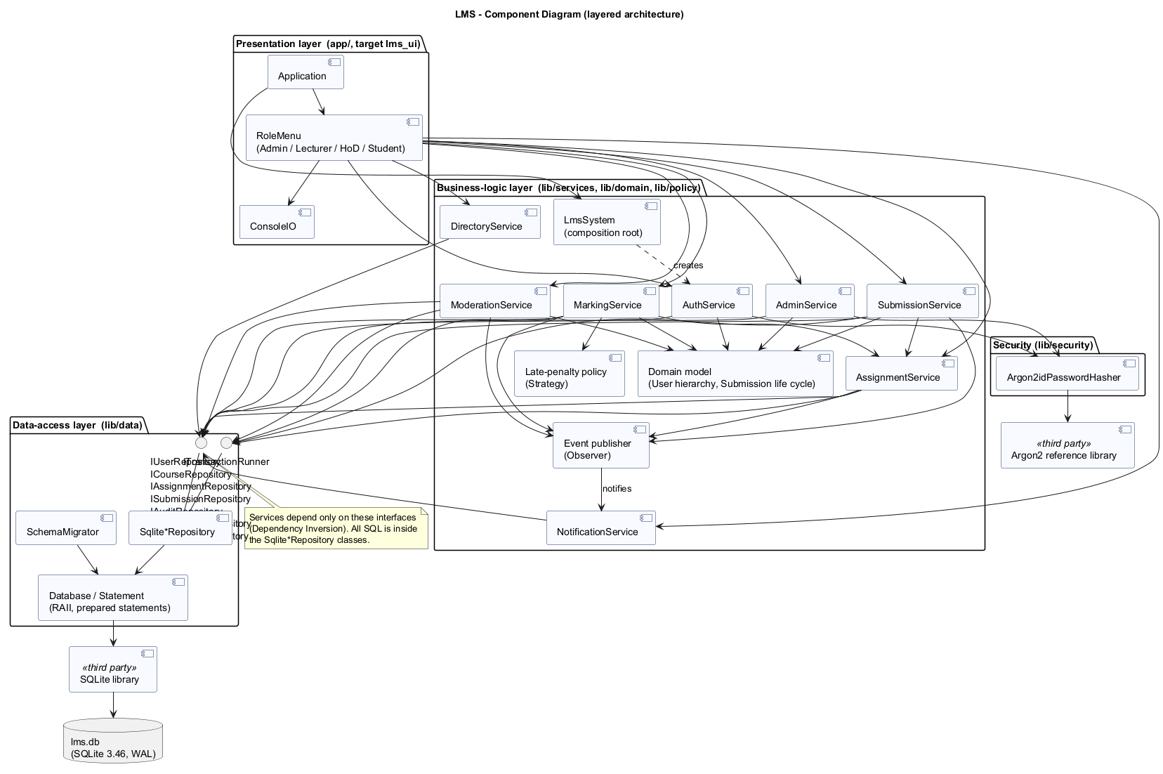
Architecture: strict layers, enforced by the build
Why layered
Business rules live in one place, tested without the console (278 tests run in about a second).
Layers are separate CMake targets: the UI cannot reach SQL.
Alternatives rejected
MVC: built for GUIs with several synchronised views; a console has one screen.
Client-server: breaks the offline, old-hardware constraint.
Menus calling SQL directly: rules scattered and untestable.
Notes:
I chose a strict layered architecture: console menus call only the business-logic layer, which depends only on repository interfaces; the data-access layer is the only code containing SQL. The layers are separate CMake targets, so the build enforces the dependency rules. I rejected MVC because it is designed for interfaces with several views that observe a changing model; a console shows one screen at a time, so MVC would only add controllers duplicating the services. Client-server would break the offline constraint. The maintenance phase later confirmed the choice: CR1 changed one service method.

Slide 7
Five design patterns, each chosen for a reason
Strategy
Late-penalty rule
Most contested rule, most likely to change; swap it without editing marking.
Repository / DAO
Data access
SQL in one file, services tested on in-memory SQLite.
Factory Method
UserFactory
One place maps a stored role to the right User subclass.
Observer
Notifications
A Could requirement: removable without touching any service.
Template Method
RoleMenu::run
Error handling written once; every role is equally robust.
SOLID
Abstract User with 4 final subclasses; 7 narrow repository interfaces; services depend on abstractions; one composition root (LmsSystem).
Notes:
The class diagram is split into three views because one diagram was unreadable. User is abstract with pure virtual functions; the four roles are final subclasses and behaviour such as department scope is dispatched polymorphically, not with role-code conditionals. Strategy for the penalty, because it is the rule most likely to change. Repository confines SQL to one file and lets services run against in-memory SQLite. Factory Method creates the right User subclass. Observer decouples notifications, which were only a Could requirement. Template Method fixes the session skeleton and error handling once. One deliberate SOLID compromise: services receive the whole bundle of seven repositories for short constructors; that is documented in the design document.

Slide 8
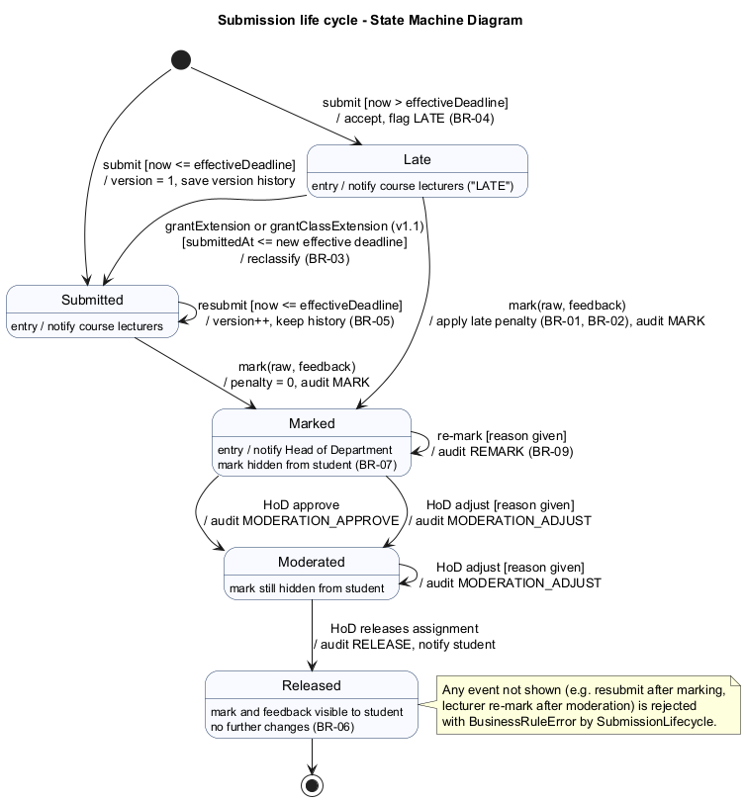
Submission life cycle: one function owns every transition
SUBMITTED / LATE
Guards = business rules
Resubmit only before the deadline
Re-mark needs a reason
RELEASED is final
MARKED
MODERATED
RELEASED
Verified exhaustively
All 25 from/to state pairs are tested, legal and illegal.
An extension can move a LATE submission back to SUBMITTED, so a confirmed excuse removes the penalty.
Notes:
Every submission follows this state machine. The guards on the transitions are the business rules: resubmission only while the effective deadline has not passed, a re-mark needs a reason, and RELEASED is final. The table of legal transitions is implemented in exactly one function, and I tested all 25 from-to pairs, so an illegal transition cannot happen anywhere in the code. Lateness is evaluated at marking time, so an extension granted after a late submission removes the penalty automatically.

Slide 9
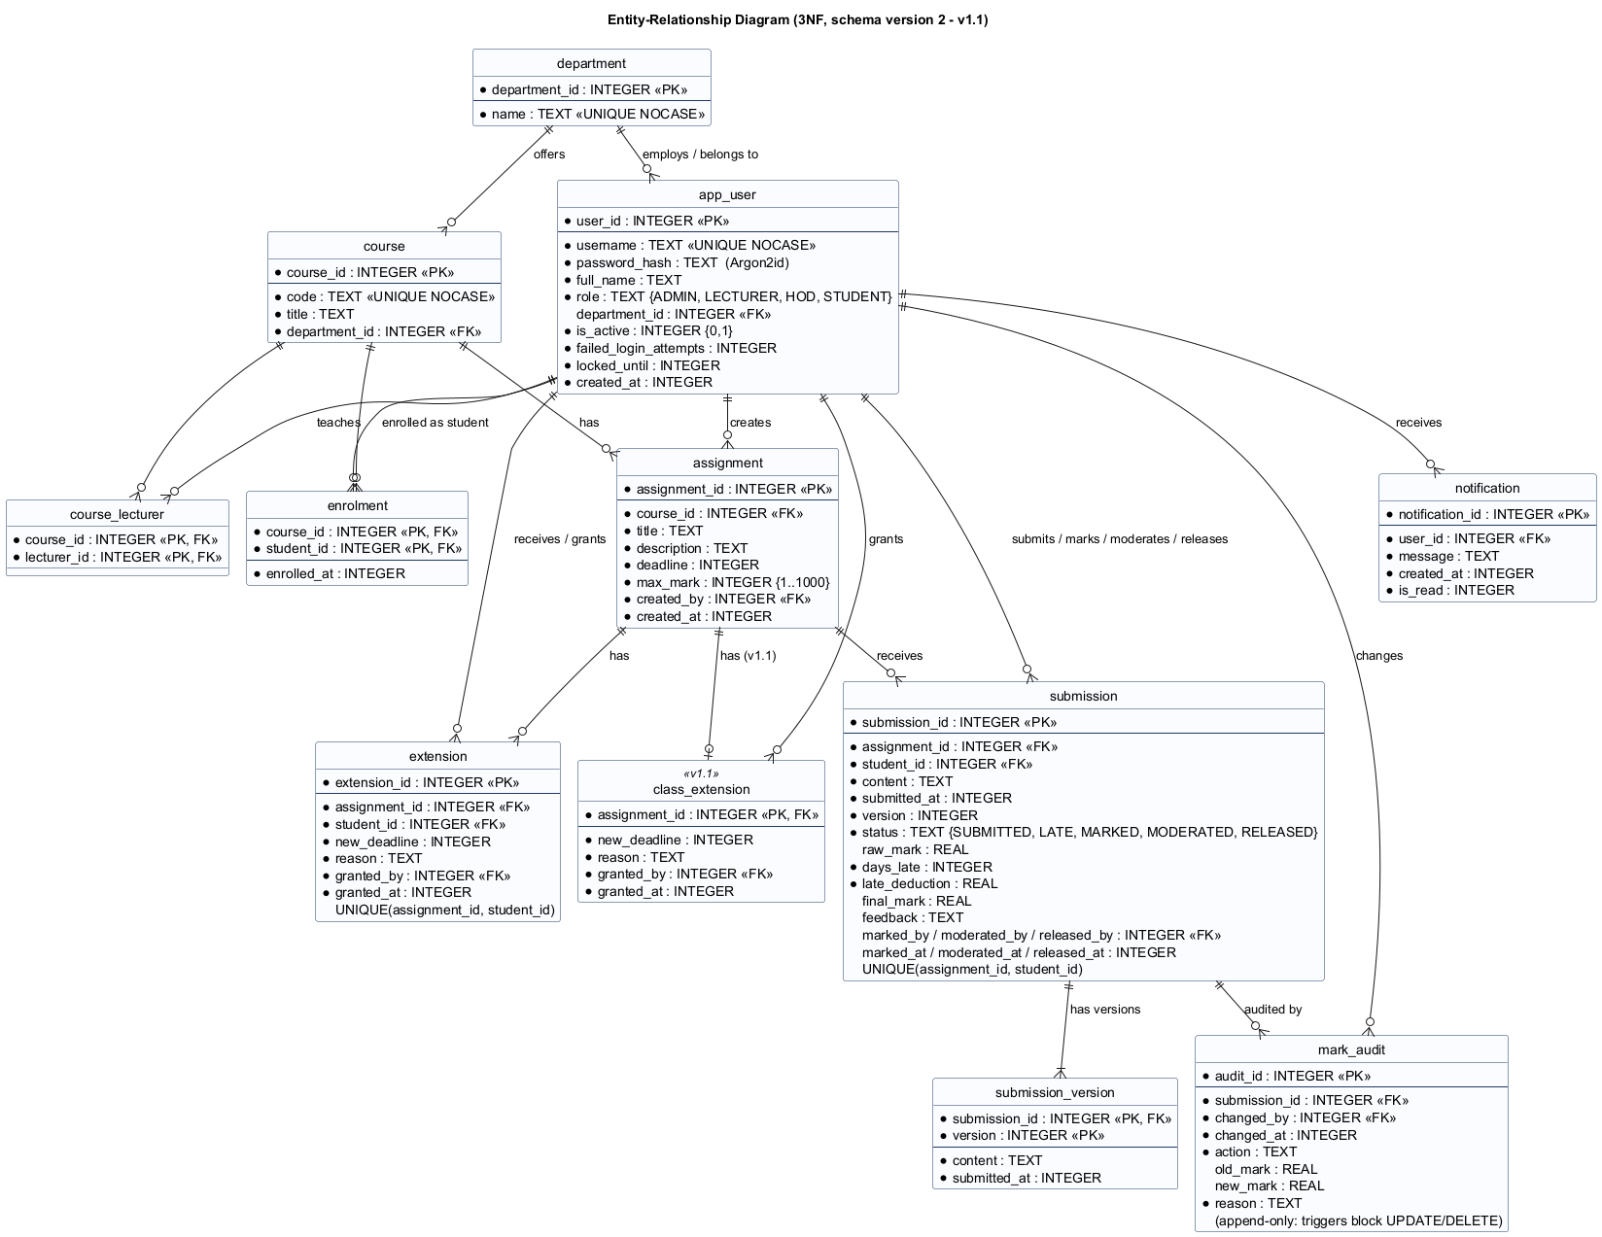
Database: 12 tables in third normal form
Single-table inheritance
4 user subclasses add behaviour, not data: one table with a role column.
final_mark stored on purpose
After moderation it is an independent fact, and a record must not change if the policy changes.
Rules in the database too
CHECK constraints, foreign keys, and triggers that make the audit log append-only.
Notes:
The ERD has twelve tables in version 1.1, normalised to third normal form: junction tables for the many-to-many relationships and a separate table for resubmission history. If asked about final_mark: it looks derivable from raw mark minus deduction, which would be a transitive dependency, but after moderation the HoD can set a different value, and an assessment record must not change silently if the penalty policy changes later. So it is stored deliberately and justified in the SDD. Users map with single-table inheritance. The database enforces rules as well as the code, and two triggers stop anyone updating or deleting audit rows.

Slide 10
Security and integrity by design
Argon2id
5 tries
100 %
Atomic
19 MiB, 2 passes, 16-byte random salt (RFC 9106, OWASP)
then the account locks for 15 minutes
of SQL with user data uses bound parameters
a mark and its audit entry are written in one transaction, or not at all
Why Argon2id, not bcrypt or PBKDF2
bcrypt truncates at 72 bytes and is not memory-hard.
PBKDF2 is not memory-hard (cheap on GPUs) and needs OpenSSL.
Parameters are stored in each hash, so they can be raised later.
Found by my code review
Login timing revealed which usernames exist: unknown users are now checked against a dummy hash.
A file submission could attach the LMS database itself: now refused.
Notes:
Passwords are hashed with Argon2id, the Password Hashing Competition winner, standardised in RFC 9106 and first choice in the OWASP cheat sheet, using the reference library. Salt comes from the operating system's secure random generator. Accounts lock for 15 minutes after five failures and the error message never says whether the username exists. All SQL uses prepared statements; a test shows that injection payloads simply fail to match. Every service call checks role and scope itself, so the menus are a convenience, not the security boundary. Two security defects were found by review, not by tests: a timing side channel at login, and a file-path submission that could have exposed the whole database to a lecturer.

Slide 11
Live demonstration: from submission to released mark
1
Start
lms --db viva.db --seed-demo (password for every demo account: Passw0rd2026)
If time allows
CR1: lect.sci extends the deadline for the whole class; the student list shows the extension.
Wrong password 5 times: account locked.
Type letters where a number is expected: re-prompt, no crash.
2
stud1
My assignments and deadlines; Submit work for Algebra homework 1 (deadline passed): stored as LATE
3
lect.sci
Mark or re-mark a submission: raw mark + feedback, late penalty applied automatically
4
stud1
My results and feedback: nothing visible yet (awaiting moderation)
5
hod.sci
Marks awaiting moderation; Approve a mark; Release moderated marks for the assignment
6
stud1
Result and feedback now visible
7
hod.sci
Audit trail of one submission: who, when, old, new, reason
Notes:
Demo script. Start with a fresh database so the demo is predictable: lms --db viva.db --seed-demo. All demo accounts use the password Passw0rd2026. 1) Log in as stud1, list assignments: Algebra homework 1 has a deadline two days in the past. Submit work: it is stored as LATE, and the rule is shown. Point out it is accepted, not rejected (conflict C2). 2) Log in as lect.sci, view submissions, mark it, for example 20 out of 25 with feedback. It is three started days late, so 30 percent of 25 is deducted. 3) Log in as stud1: no mark is visible yet; that is the principal's rule. 4) Log in as hod.sci: marks awaiting moderation, approve, then release for the assignment. 5) stud1 now sees the mark and feedback. 6) hod.sci shows the audit trail. Rehearse this at least twice on the machine you will use. Have the built lms.exe ready; do not build live.

Slide 12
Verification: every V-Model level, measured
95.9 %
153 ms
line coverage of business logic (target 70 %)
login with 800 students stored (limit 2 s)
338 ms
278 / 278
release 800 marks in one action
functional tests pass after v1.1, on GCC and Clang
How cases were chosen
Equivalence partitions and boundaries for deadlines, penalties and passwords; all 25 state transitions; 52 role-permission pairs.
Notes:
The test plan maps each V-Model level to the artefact it verifies: unit tests the detailed design, integration tests the architecture against real SQLite in memory, system tests the SRS by driving the real console with scripted input, one test per use-case flow, and acceptance tests validate stakeholder needs. Coverage of the business-logic layer is 95.9 percent against a target of 70. Branch coverage is lower, 59 percent, because GCC counts hidden exception branches; I report it but did not target it. Performance requirements were met with wide margins. One acceptance test, AT-06, needs a real first-time user and has not been run yet; the test report says so.

Slide 13
Tests, reviews and tools each found different defects
Unit test
DEF-01
Penalty policy accepted NaN: raw < 0 || raw > max is false for NaN.
8 defects
logged with severity, cause, fix commit and retest result
Code review
DEF-04, DEF-05
Login timing side channel; database file could be submitted as work.
19 -> 14
Second compiler
DEF-03
GCC warning Clang missed; would have broken the Linux CI build.
highest cyclomatic complexity after refactoring (limit 15)
Configuration management
GitHub Flow: short feature/fix/docs branches merged to main; tags v1.0 and v1.1; CI defined for every push.
Static analysis
16 + 59 -> 0
cppcheck and clang-tidy findings fixed or justified; one bad suggestion rejected.
Notes:
My main quality lesson: different techniques find different defects. A unit test found the NaN defect: the range check was false for NaN, so I rewrote it in the positive form, and later rejected clang-tidy's suggestion to simplify it back. Review found both security defects, which escaped 260 tests. Building with a second compiler found a warning that would have broken Linux CI. Both static analysers now report zero findings. Two functions exceeded my complexity limit of 15 and were refactored. Configuration management uses GitHub Flow with release tags; CI is defined in GitHub Actions. Be honest if asked: CI runs once the repository is pushed to GitHub; locally I reproduced every CI job.

Slide 14
CR1: class-wide extensions, released as v1.1
"A lecturer should be able to extend the deadline for a whole class, and extensions should be shown on the student's assignment list."
1
2
3
4
Classify
Perfective: v1.0 met its spec; users want new function. Small adaptive part: upgrade v1.0 databases.
Impact analysis
FR-09, FR-19, BR-03, new FR-22; UC-16; class views, ERD, state, activity, sequence; 1 new table.
Implement
One new table and the single effective-deadline method; submission and marking services unchanged.
Regression
Old suite unchanged: 263 / 264, only ST22 failed, as predicted. With 14 new tests: 278 / 278.
Effective deadline = the latest of the original deadline, the class extension and the student's own extension. Computing it in exactly one place is why late status, penalties and resubmission all followed automatically.
Notes:
CR1 is perfective maintenance in the Lientz and Swanson sense: v1.0 met its specification, there was no defect, and the environment did not change. Users asked for new functionality after using the system. Before coding I clarified it: a whole class is everyone enrolled; one class extension per assignment; the effective deadline is the latest of the three, so neither kind of extension shortens the other; refused after moderation. The impact analysis listed every affected requirement, diagram, class, table and test, and predicted that exactly one system test, ST22, would fail because it checked the old display text. That is exactly what happened: 263 of 264. After updating that expectation and adding 14 tests, all 278 passed and coverage rose to 96.1 percent.

Slide 15
Professional, legal and ethical issues
1
Data protection
Lesotho Data Protection Act 2011: minimal data, role-restricted access, kept on the school PC. Retention and backups are the school's duty.
2
Security of records
Separation of duties (lecturer marks, HoD moderates), RELEASED is final, append-only audit log.
3
Accessibility
Console works with screen readers (NVDA, Narrator), no colour-only meaning, keyboard only, no time limits.
4
Fairness of penalties
One tested rule instead of manual arithmetic; shown at submission; extensions need a reason and leave a trace.
Notes:
Most learners are minors, so data protection matters. The Lesotho Data Protection Act 2011 requires lawful, minimal, accurate and secure processing; the design stores only what assessment needs, restricts access by role in every service call, and keeps data on the school's computer. I state openly what the software cannot do: retention periods, backup encryption and physical security are the school's responsibility, and the database file itself is not encrypted. For fairness, the penalty is applied consistently and transparently, and compassion is easy but visible: extensions and moderation adjustments need a reason and are audited. Because the penalty is a Strategy, the school could adopt a gentler rule without rewriting the system.

Slide 16
Reflection, limitations and future work
What I learned
Look for the need behind each stakeholder statement instead of picking a winner.
Tests, reviews, a second compiler and static analysis each find defects the others miss.
Waterfall's rigidity was reduced, not removed: the real timeline was more compressed than the plan, and I recorded that honestly.
Limitations
One computer at a time; database file not encrypted
Usability test AT-06 and GitHub CI run still outstanding
Future work
Client-server version for several computers
Encryption at rest (SQLCipher)
Controlled correction of released marks
Notes:
To conclude: the system meets every Must requirement, with the full chain of artefacts from plan to a maintained second release. The best evidence the design was sound is CR1: a change to the central concept of the deadline was absorbed by one method and one additive table. Three lessons: find the need behind conflicting statements; combine testing, review and tools; and be honest about plan versus actual. The limitations are listed openly, with future work in order of value to the school.

Slide 17
Thank you
Questions are welcome on any part of the design or the code
Notes:
Invite questions. If asked about a specific function, open it in the editor rather than answering from memory: say which file it is in, then walk through it. Backup slides follow with short answers to likely questions.

Slide 18
Backup: likely questions (1 of 2)
Why store final_mark if it can be derived?
After moderation it is an independent value set by the HoD, and a record must not change if the penalty policy changes.
How do you guarantee every mark change is audited?
The mark and its audit row are written in one transaction; triggers make the audit table append-only.
What if the database write fails halfway?
The transaction rolls back, a DatabaseError is shown in plain language, and the session continues.
Why a console, not a GUI?
Brief allows either; console runs on old PCs, works with screen readers, and the layers allow a GUI later.
Why GitHub Flow, not Git Flow?
One developer, two releases: develop/release branches would double merges without adding a real gate.
Notes:
Backup slide: show only if a question comes up. Know where each answer lives in the code: penalty in lib/src/policy/LatePenaltyPolicy.cpp; effective deadline in AssignmentService::deadlineFor; marking and audit in MarkingService.cpp; release in ModerationService.cpp; hashing in PasswordHasher.cpp; SQL only in SqliteRepositories.cpp; state transitions in SubmissionStatus.cpp; schema in sql/.

Slide 19
Backup: likely questions (2 of 2)
Where are role permissions enforced?
In every service call (role, then scope, then input, then rule). Menus only hide options.
How does an extension change a late penalty?
Lateness is measured at marking time against the effective deadline then, so the penalty disappears.
Why is branch coverage only 59 %?
GCC counts hidden exception branches for every throwing call; line coverage 95.9 % is the target metric.
What did you not verify?
AT-06 needs a real first-time user, and CI has not yet run on GitHub. Both are stated in the reports.
Did you use AI assistance?
Answer honestly. The report says the student stays responsible for understanding and explaining every part.
Notes:
Backup slide: show only if a question comes up. Know where each answer lives in the code: penalty in lib/src/policy/LatePenaltyPolicy.cpp; effective deadline in AssignmentService::deadlineFor; marking and audit in MarkingService.cpp; release in ModerationService.cpp; hashing in PasswordHasher.cpp; SQL only in SqliteRepositories.cpp; state transitions in SubmissionStatus.cpp; schema in sql/.

